Slide 1

EE 396V | Graphene Electronic Tattoos and Biosensor Applications
Thomas Plantin & Naiqiao Yang
10/21/19
EE 396V
Thomas P. & Naiqiao Y.

Slide 2
EE 396V | Overview
What are GETs (Graphene Electronic Tattoos)?
How GETs are made
Mechanical Properties - Design for optimum stretchability
Key potential applications
Comparison with commercial gel electrodes
Conclusion
EE 396V
Thomas P. & Naiqiao Y.
Notes:
Let me walk you through an overview of the topics that we will be addressing throughout this presentation.
I will begin by explaining what GETs are and how they are made. Then we will observe some mechanical properties of these devices.
My partner Naiqiao will then discuss key potential applications for these devices.
I will compare the GETs with commercial gel electrodes.
And Naiqiao will conclude by summarizing the current challenges / state of the art
Thomas:
1 - How GET (Graphene Electronic Tattoos) are made
2 - Design for optimum stretchability
4 - Comparison with commercial gel electrodes
Naiqio:
3 - Key potential applications (Include electrical properties)
5 - Conclude by summarizing current challenges

Slide 3
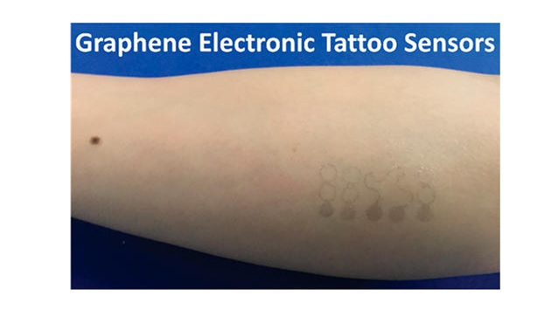
EE 396V | What are GETs (Graphene Electronic Tattoos)?
Electronic tattoos made of graphene and used as biosensors.
Some applications include:
Electrophysiological sensor.
Resistance Temperature detector.
Skin Hydration sensor.
EE 396V
Thomas P. & Naiqiao Y.
Notes:
Graphene is the thinnest electrically conductive material, optically transparent, mechanically robust, electrochemically stable, and biocompatible – ideal prerequisites for fabricating epidermal electronics or tattoo-type biosensors.

Slide 4
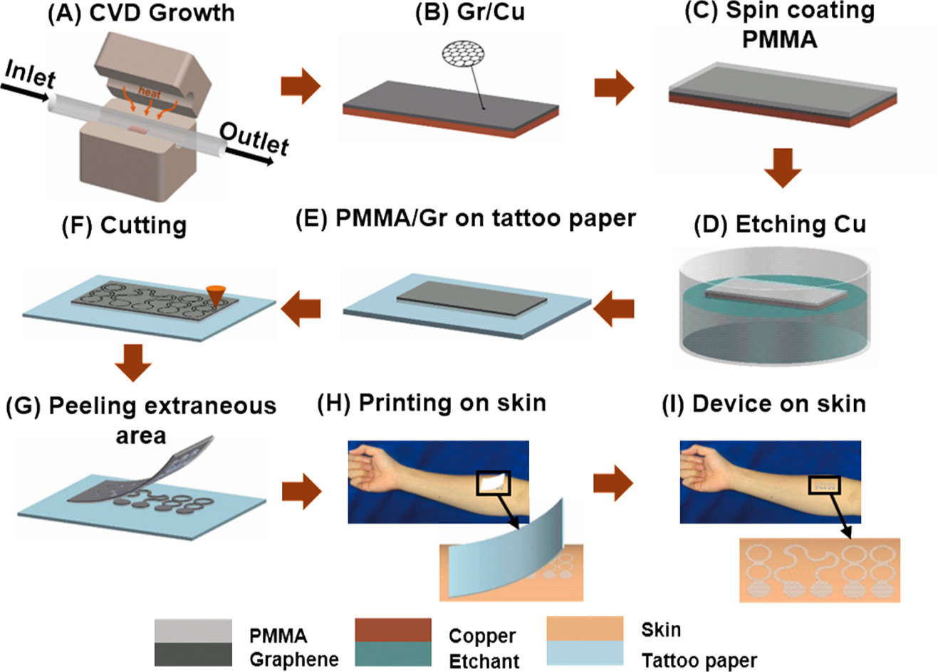
EE 396V | How GET (Graphene Electronic Tattoos) are made
Figure 1: GETs are manufactured by a low-cost “wet transfer, dry patterning” process on tattoo paper.
EE 396V
Thomas P. & Naiqiao Y.
Notes:
A - B: Using APCVD, Graphene was grown on a layer of Cu foil.
C: PMMA (Poly Methyl/Methacrylate) was spin coated to ease transfer process and prevent contamination.
D: Cu was etched away.
E: Gr/PMMA was transferred onto tattoo paper, with Gr side facing up.
F: The desired design for the tattoo was cut using a mechanical cutter plotter.
G: The extraneous area is peeled off.
H: Just like a normal tattoo for kids, it is printed on the skin.
I: Simply remove the paper, and the device is now fixed to the skin.
Chemical vapor deposition (CVD) is a vacuum deposition method used to produce high quality, high-performance, solid materials. The process is often used in the semiconductor industry to produce thin films.

Slide 5
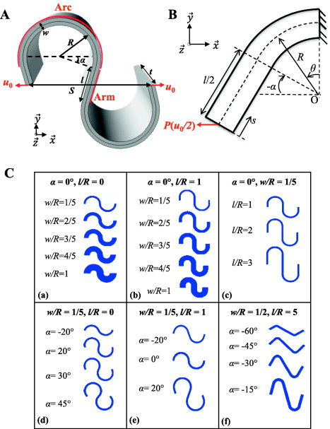
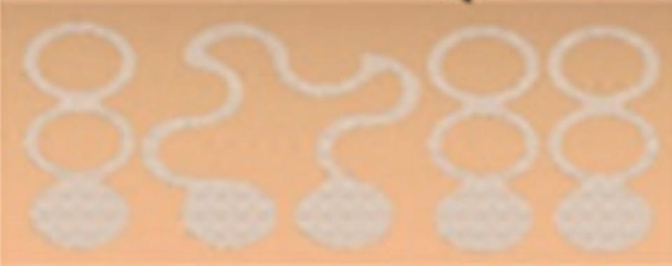
EE 396V | Mechanical Properties - Design for optimum stretchability
Optimum stretchability when:
Small w/R
Large l/R
Large 𝛼
GEPS
GRTD
GSHS
EE 396V
Thomas P. & Naiqiao Y.
Notes:
GEPS: Graphene ElectroPhysiological Sensor
GRTD: Graphene Resistance Temperature Detector
GSHS: Graphene Skin Hydration Sensor
The serpentine ribbons were designed with a width of 0.9 mm and a radius of 2.7 mm to ensure the GET has a stretchability greater than that of skin.

Slide 6
EE 396V | Why Graphene?
Intimate sensor-skin integration
Optically imperceptible
Mechanically robust
Electrochemically stable
...
EE 396V
Thomas P. & Naiqiao Y.
Notes:
The GET EOG sensor system presented here has a thickness of 350 nm,
optical transparency of 85% in the visible regime (wavelength from 400 to 800 nm)

Slide 7
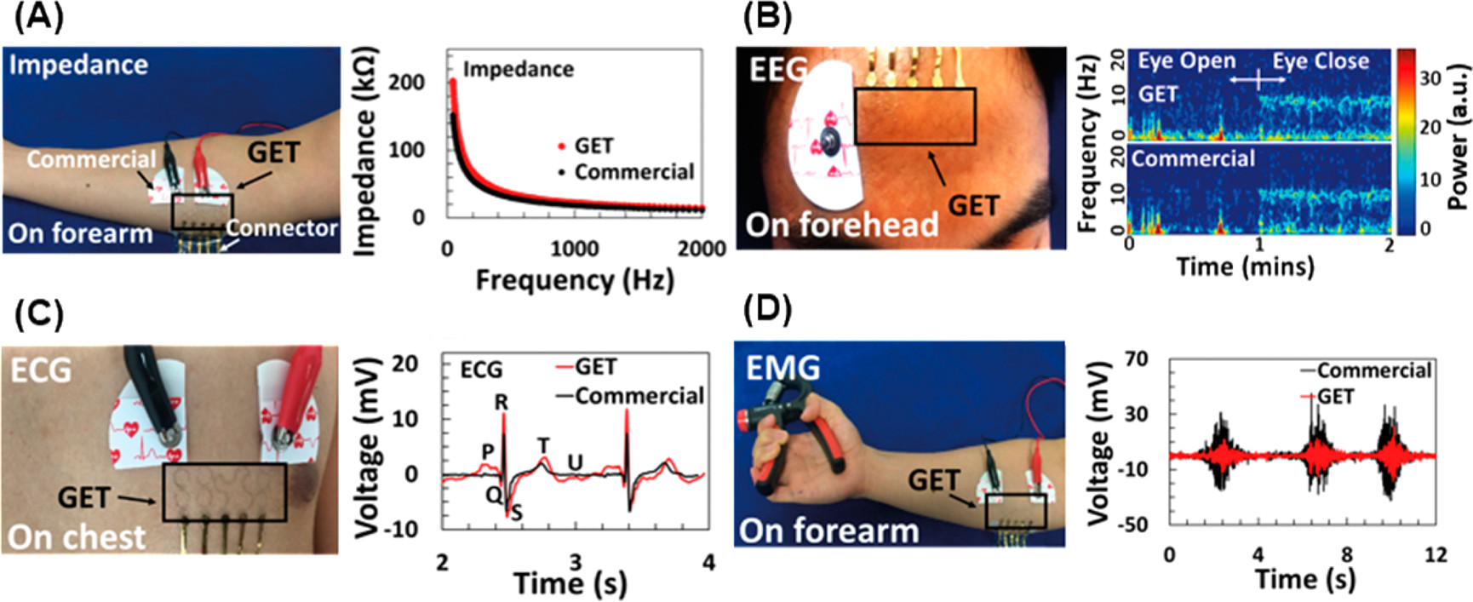
EE 396V | Key applications
GET electrodes
Classical electrical circuit concept suggest that the electrode-skin interface impedance is inversely proportional to the contact surface area.
Low contact impedance is essential for a high SNR in electrophysiological measurements.
Higher surface charge density and surface electric displacement field of graphene results in more efficient capturing of electrical potential, and thus higher SNR.
Electrical performance of GET vs Ag/AgCl gel -skin interface
EE 396V
Thomas P. & Naiqiao Y.

Slide 8
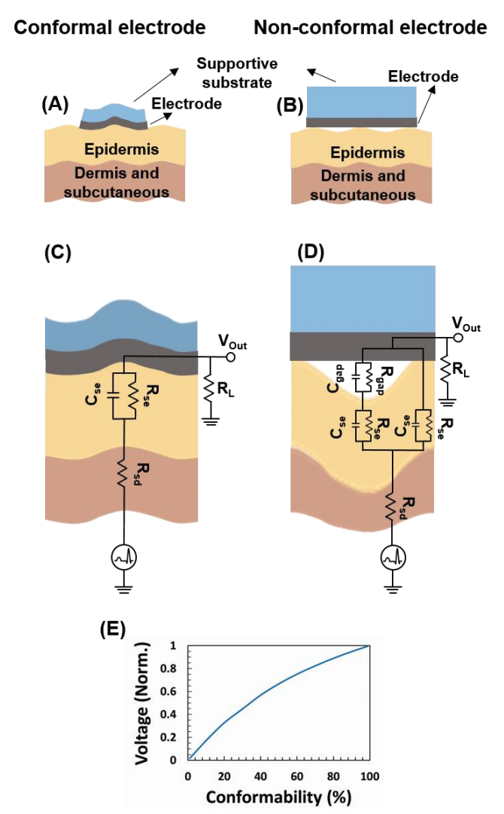
EE 396V | Key applications
More on GET electrodes
Circuit models and simulations for conformal and non-conformal electrodes.
EE 396V
Thomas P. & Naiqiao Y.

Slide 9
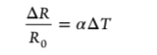
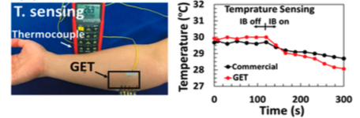
EE 396V | Key applications
Resistance temperature detector(RTD)
For a given temperature change, a large ΔR requires a large R₀.
Since metal in general have lower resistivity. A large R₀ requires longer metal wire.
Graphene has a sheet resistance of ~2kΩ and RTD can be shorter in length and smaller in size.
EE 396V
Thomas P. & Naiqiao Y.

Slide 10
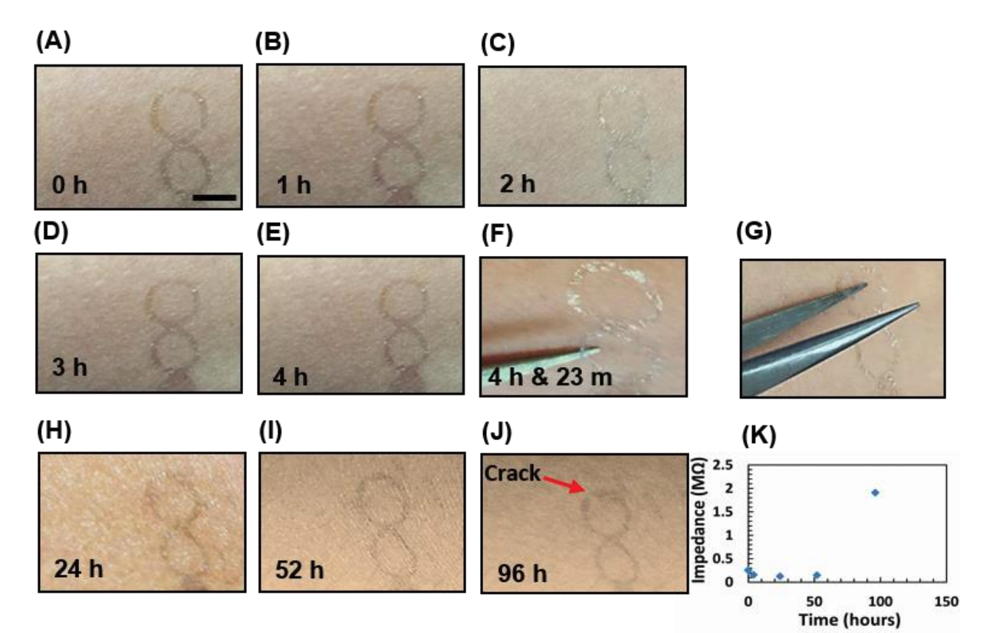
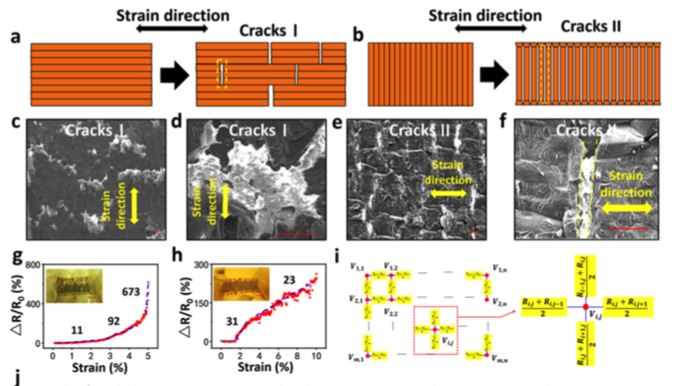
EE 396V | Challenges
Durability
Reference: Multilayer Graphene Epidermal Electronic Skin
EE 396V
Thomas P. & Naiqiao Y.
Notes:
When no tape, adhesive, or liquid bandage was used, the GET stayed conformal to the skin for more than 4 h. The first delamination was observed after 4 h and 23 min(A-G)
Liquid bandage has been applied by previous researchers to seal electronic tattoos directly printed on the skin(H-J)
No cracks or delamination was observed for up to 52 h after the transfer,
96 h after the transfer a crack was visible in the serpentine ribbon and hence the corresponding impedance increased by 1 order of magnitude

Slide 11
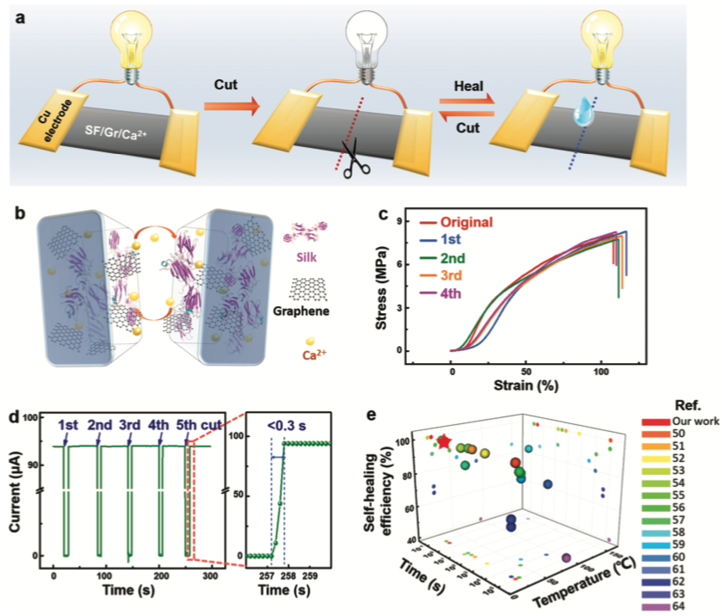
EE 396V | Some recent researches
Self-healable E-tattoo by incorporating graphene with Silk Fibroin(SF)/Ca²⁺ films.
Water molecules swell up SF chains and viscoelasticity of the film increased, leading to physical fusing of two parts.
Intrinsic hydrogen bonds and coordination bonds between Ca²⁺ and -COO-.
Reference: Self-Healable Multifunctional Electronic Tattoos Based on Silk and Graphene
EE 396V
Thomas P. & Naiqiao Y.

Slide 12
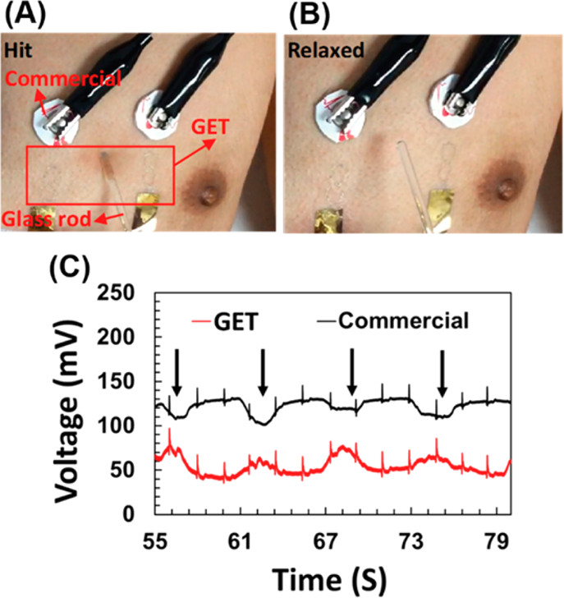
EE 396V | Comparison with commercial gel electrodes
EE 396V
Thomas P. & Naiqiao Y.

Slide 13
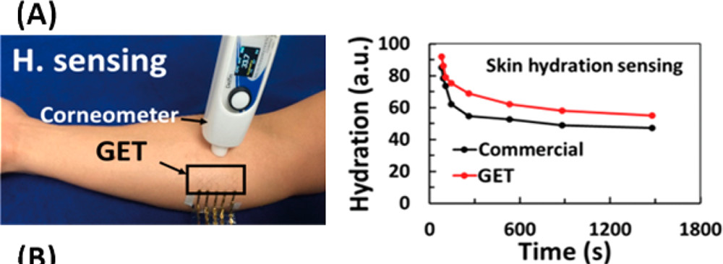
EE 396V | Comparison with commercial gel electrodes
EE 396V
Thomas P. & Naiqiao Y.
Notes:
Corneometry is a widely practiced method for the measurement of skin hydration. It uses a capacitive sensor to measure the relative permittivity of upper skin layers. Because these depend on hydration of skin, the measured value is a measure for skin hydration.

Slide 14
EE 396V | Conclusion
As tattoo-like wearable skin hydration and temperature sensors, the GET has been validated by state of the art gold standards.
It is believed that the GET has opened a door for two-dimensional materials to be applied in biosensing electronic tattoos, as well as many other applications.
Challenges include increasing the durability of GETs, as they currently last up to 90-100 hours.
Some recent researches proposed self-healable E-tattoo as a promising candidate for bio-sensing.
EE 396V
Thomas P. & Naiqiao Y.

Slide 15
EE 396V | References
[1] Ameri, S. K.; Ho R.; Jang, H.; Tao, L.; Wang, Y.; Wang, L.; Schnyer, D. M.; Akinwande, D.; Lu, N. “Graphene Electronic Tattoo Sensors” ACS Nano, vol. 11, no. 8, July 18, 2017. [Online]. Available: https://pubs.acs.org/doi/10.1021/acsnano.7b02182. [Accessed Oct. 10, 2019].
[2] Widlund, T.; Yang, S. X.; Hsu, Y. Y.; Lu, N. S. “Stretchability and Compliance of Freestanding Serpentine-Shaped Ribbons” Int. J. Solids Struct. 2014, 51, 4026– 4037DOI: 10.1016/j.ijsolstr.2014.07.025 [Crossref], [CAS], [Google Scholar]
[3] Qiao, Y.; Wang, Y. “Multilayer Graphene Epidermal Electronic Skin” ACS Nano, vol. 12, no. 9, July 24, 2018. [Online]. Available: https://doi.org/10.1021/acsnano.8b02162. [Accessed Oct. 14, 2019].
[4] Wang, Q.; Ling, S. “Self-Healable Multifunctional Electronic Tattoos based on Silk and Graphene” Advanced Functional Materials, vol. 29, no. 16, February 25, 2019. [Online]. Available: https://onlinelibrary.wiley.com/doi/full/10.1002/adfm.201808695. [Accessed Oct. 14, 2019].
[5] Ameri, S. K.; Kim M.; Akinwande, D.; Lu, N. “Imperceptible electrooculography graphene sensor system for human-robot interface” Nature Partner Journals, vol. 11, no. 3, July 24, 2018. [Online]. Available: https://doi.org/10.1038/s41699-018-0064-4. [Accessed Oct. 16, 2019].
EE 396V
Thomas P. & Naiqiao Y.

Slide 16
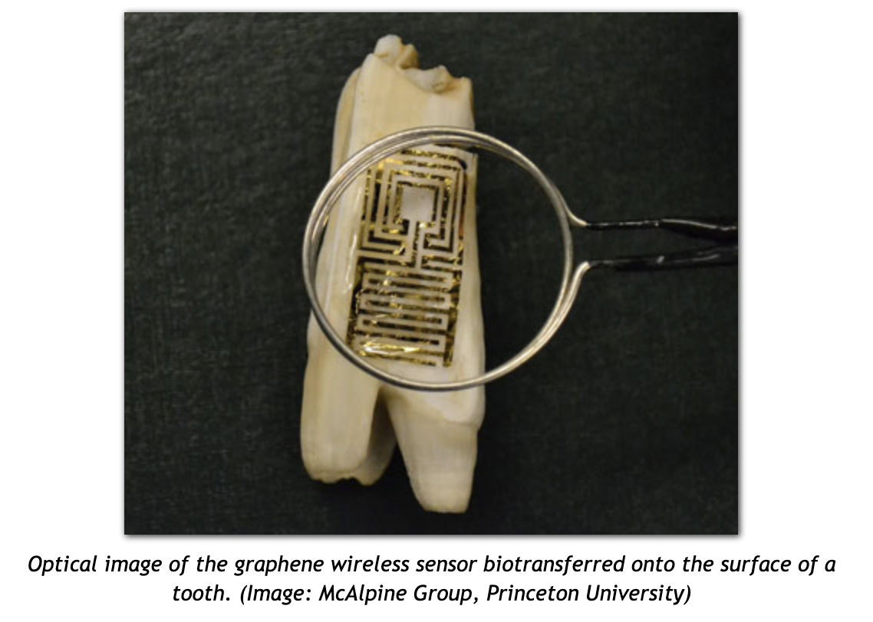
EE 396V | Extras
EE 396V
Thomas P. & Naiqiao Y.
Notes:
Graphene is the thinnest electrically conductive material, optically transparent, mechanically robust, electrochemically stable, and biocompatible – ideal prerequisites for fabricating epidermal electronics or tattoo-type biosensors.
For tooth: to monitor bacteria

